Slide 1
BOOTCAMP TRAINING
By: - Ayushi Jain
Email- ayushi.jain2@shell.com
IDA – Associate Data Engineer

Slide 2
Soft skills training
( AUGUST 14 – AUGUST 17 )

Slide 3
Day-1 (14th August 2023 ) Soft Skills Session
Becoming Familiar: An ingenious twist in this part assisted me in forming a fresh connection.
Adopting Professionalism: Pragmatic and thoughtful method of approaching thought, behavior, and action.
Overcoming Communication Barriers: Various challenges like physical and technical elements were discussed.
Individual Appearance: Recognized the significant impact of grooming on the domain of professionalism (Chit-Drawing Activity).

Slide 4
Day-2 (16th August 2023 ) Soft Skills Session
Importance of Trust: Gained insights into the vital role trust plays in the professional sphere via an enjoyable group exercise (blind game activity).
Stakeholder Dynamics: Explored various stakeholder types and their significance in the organization's broader framework.
Nurturing a Growth Mindset: Developed an understanding of diverse mindset elements, including fostering a positive outlook, through effective explanation.
Johari Window Insights: Acquired knowledge about the four facets of the Johari Window model via an engaging group task.

Slide 5
Day-3 (17th August 2023 ) Soft Skills Session
Collaborative Effort: Gained extensive insights into teamwork through an enjoyable group endeavor (newspaper activity). Learning how to guide a team, establish structure, and accomplish tasks were standout takeaways from this dynamic experience.
Effective Email Practices: Explored various facets of email etiquette, encompassing topics such as refraining from using clashing colors, and more.
Power Point Presentation : Representing your content delivering and tone modulation skills via engaging ppt.

Slide 6
FOUNDATIONAL BOOTCAMP training
( AUGUST 18 – AUGUST 28 )

Slide 7
Day-4 (18th August 2023 ) BA -Requirements and Agile
Software Development Progression: Attained comprehension of distinct stages in the SDLC, covering the journey from idea generation and planning to coding and eventual release.
User Depictions: Investigated the notion of user narratives that delineate various user categories, their needs, and underlying motivations.
Significant Undertakings: Acknowledged that an epic functions as a comprehensive manual for the development squad, furnishing essential components for successful implementation. Essentially, it stands as the pinnacle of their task hierarchy.
Efficient Oversight Approaches: Briefly explored managerial strategies encompassing the Work Breakdown Structure, Gantt Chart, and Critical Path Method.

Slide 8
Day-5 (21st August 2023 ) BA -Requirements and Agile
Understanding Definition of Ready (DOR) & Definition of Done (DOD): Explored these notions briefly, with the aim of establishing a clear understanding of user stories, epics, and associated components.
Introduction to Scrum Board: Covered the basics comprehensively, and a practical tutorial on a virtual machine significantly enhanced my grasp of its functions.
Comparing Scrum and Kanban: Provided a thorough explanation of Kanban, followed by a detailed comparative study between Kanban and Scrum, meticulously presented in a tabular format.
Effective Use of Reports & Charts: Explored various types of reports and charts, such as burn-up, burn-down, and velocity charts, each serving distinct purposes.

Slide 9
Day-6 (22nd August 2023 ) DBMS
Management of Database Systems (DBMS): Covered fundamental elements of DBMS, including an effective approach to subjects like ER Diagrams. Explored the definitions of data, databases, database systems, and relational database systems.
Introduction to PostGreSQL Fundamentals: Explored initial aspects such as essential terms and the fundamental structure of queries within PostGreSQL.
Exploration of Join Operations: Attained insights into diverse join types and their suitable applications, constituting a significant learning point from the discussion.
Understanding Sub-Queries: Grasped the concept through practical illustrations, involving complex and demanding scenarios, thereby enhancing comprehension of this subject.

Slide 10
Day-7 (23rd August 2023 ) Software Testing
Insights into Testing: Explored topics like software testing, software failures, and the distinct phases within the software test life cycle (STLC) through comprehensive discussions.
Diverse Testing Approaches: Explored testing classifications including static and dynamic testing, manual and automated testing, offering a comprehensive approach to the subject.
Practical JUnit Tutorial: Participated in a hands-on guide to JUnit, significantly augmenting understanding of the testing phase.
Agile's Effect on Testing: Examined concepts such as TDD, ATDD, BDD, and DDD in intricate detail, emphasizing their influence within the realm of Agile methodologies.

Slide 11
Day-8 (24th August 2023 ) DevOps
Essential Concepts of DevOps: Began by clarifying the core essence of DevOps and its intrinsic necessity, forming a strong foundational understanding. Subsequently, delved into the DevOps life cycle, its guiding principles, and the benefits it offers.
Grasping CI/CD Pipelines: Acquired knowledge about both Continuous Integration and Continuous Deployment aspects within software projects, and how DevOps contributes to their successful implementation.
Exploration of Diverse Tools: Explored a range of tools including JIRA, Git, Github engaging in discussions regarding their roles and functionalities.
Practical Experience with GitHub Actions: Participated in a hands-on tutorial involving GitHub and its actions, effectively addressing inquiries and enhancing comprehension through practical engagement.

Slide 12
Day-9 (25th August 2023 ) Cloud
Azure Insights Unveiled: Initiated with dialogues about core cloud concepts, encompassing cloud definitions, types, and an introductory glimpse into Azure. Subsequently, delved into a spectrum of Azure service categories.
Demystifying Cloud Computing Services: Explored the differentiations among Infrastructure as a Service (IAAS), Platform as a Service (PAAS), and Software as a Service (SAAS), substantiated with real-world scenarios.
Introduction to IAC (Infrastructure as Code): Embarked on an enthralling expedition into the realm of IAC, unveiling this innovative DevOps technology paradigm. Learning was further enriched through a real-world portrayal involving Terraform.

Slide 13
Day-10 (28th August 2023 ) Case Study
Created user story, epics, tasks and bugs
Forked the GitHub repository
Creating a pull request
Worked on Azure VM
Used GitHub actions and workflow
Installed and ran maven on VM
Installed Docker
Azure web app configuration

Slide 14
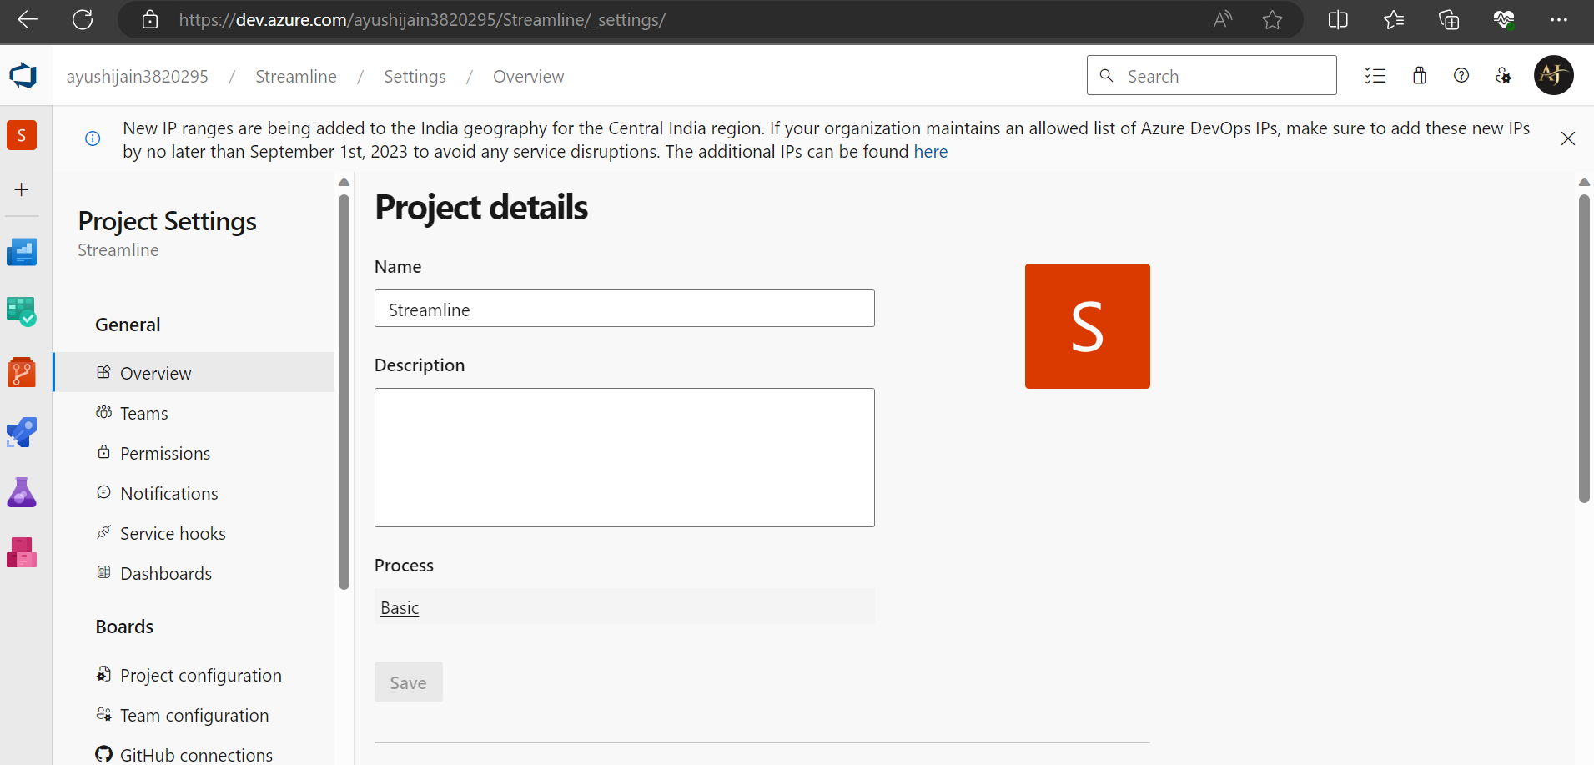
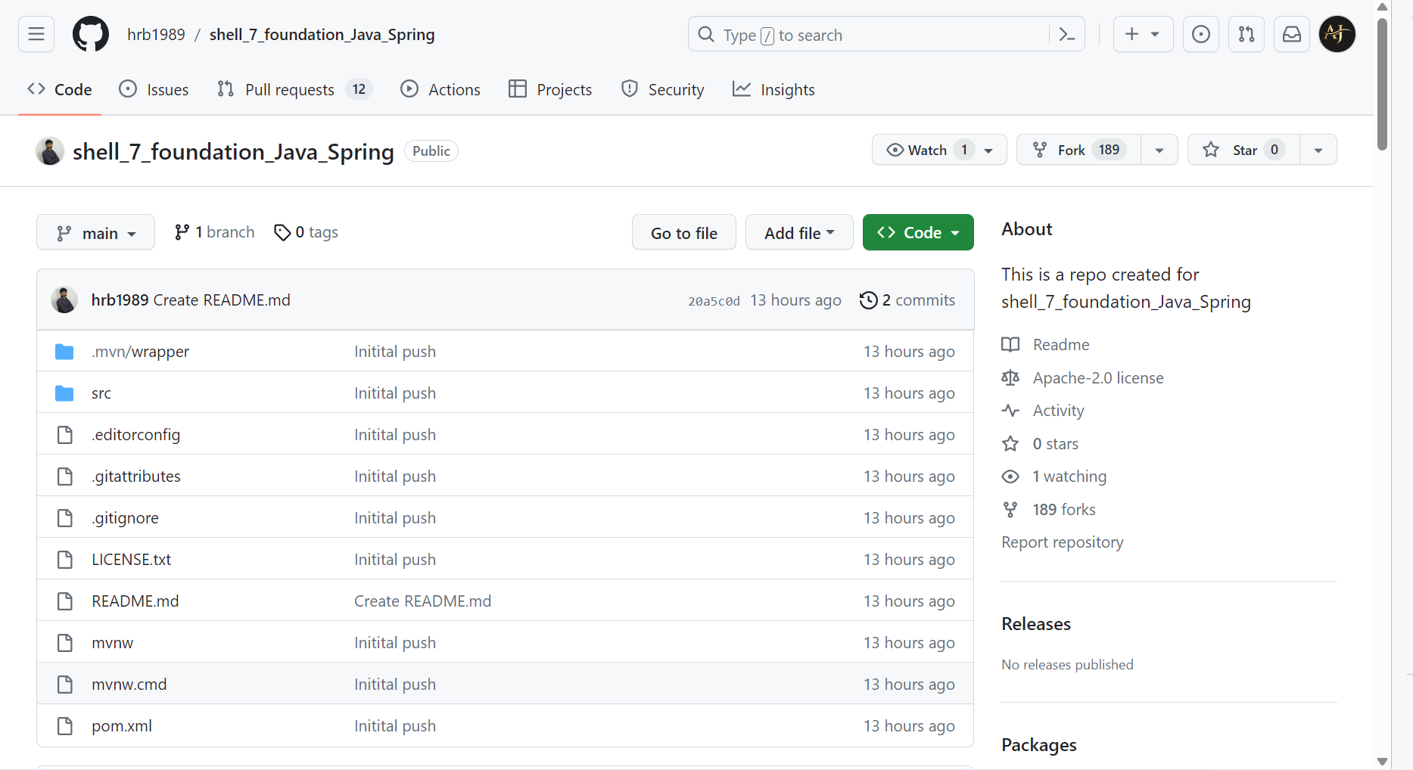
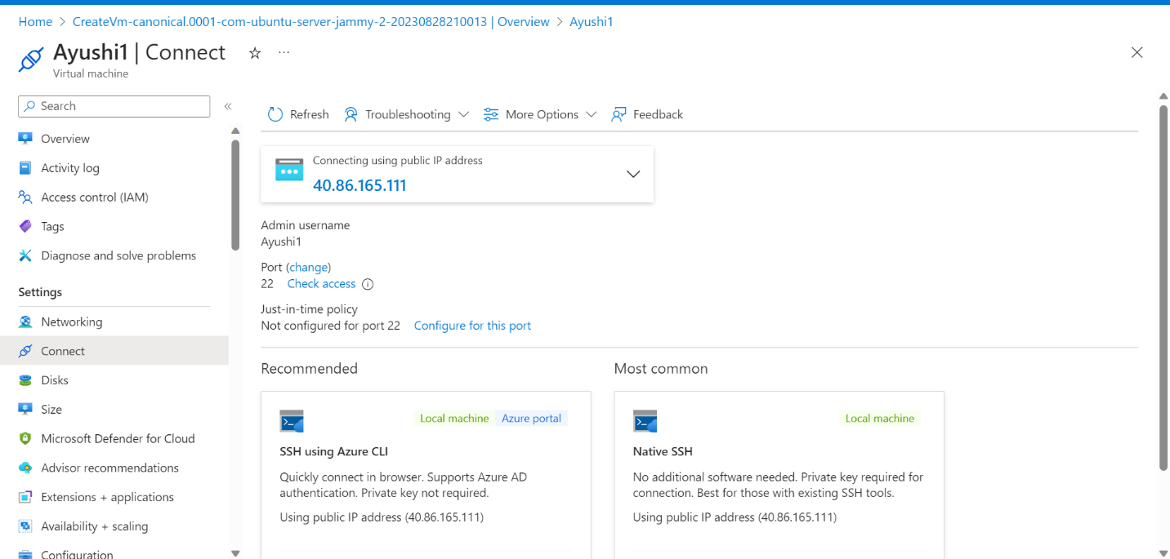
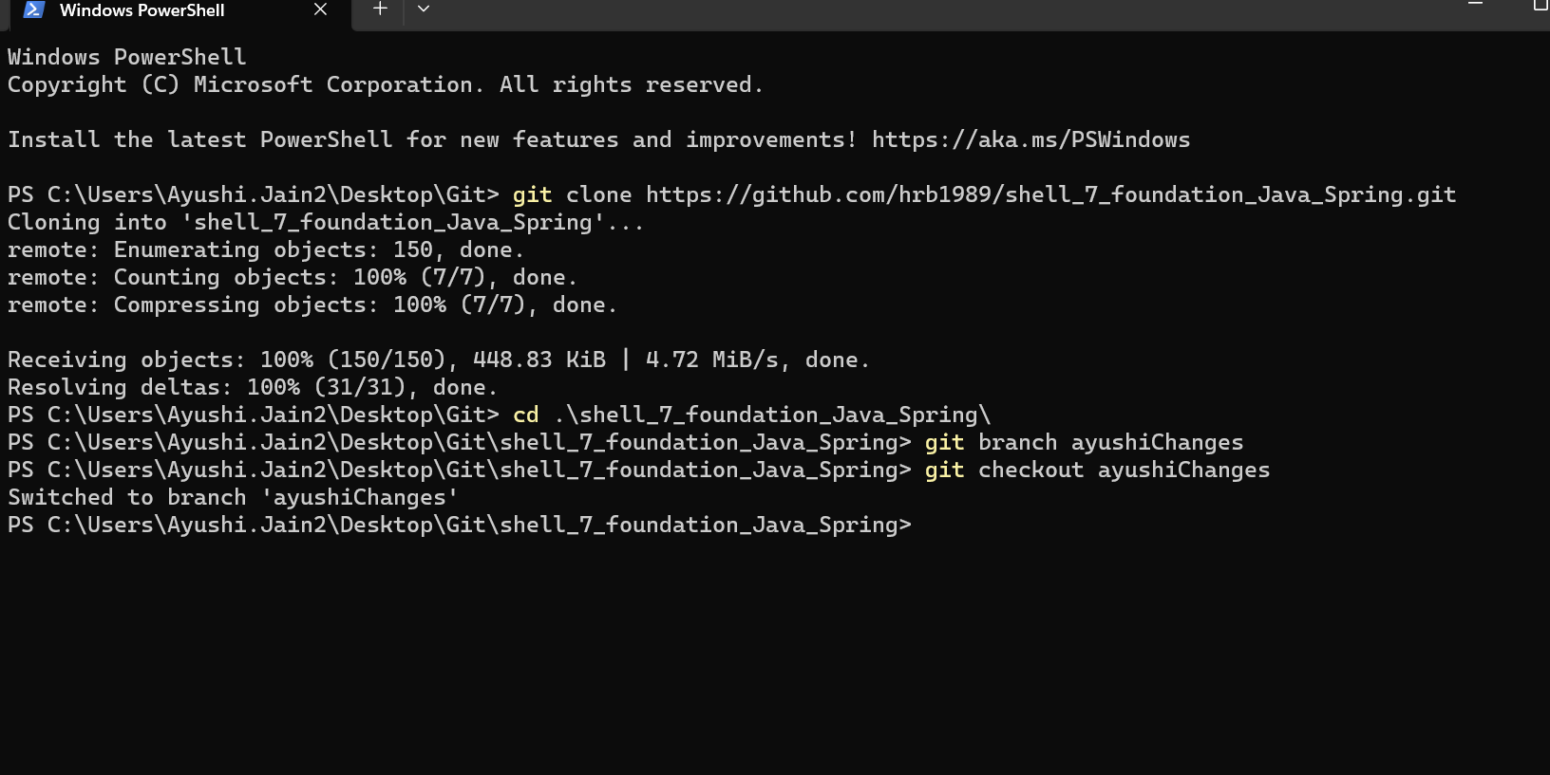
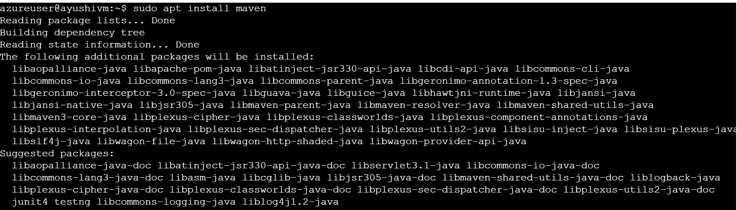
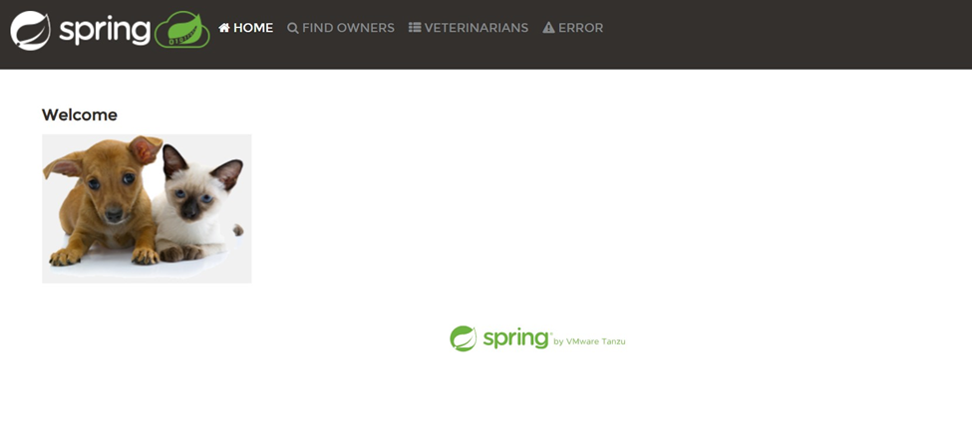
.

Slide 15
CUSTOM BOOTCAMP training
(AUGUST 29 – OCTOBER 6)

Slide 16
Day-11 (29th August 2023 ) Data Fundamentals
Database
SQL
ER Diagram
Normalization
Denormalization
Dimension Modelling
SCD

Slide 17
Day-12 (30th August 2023 ) Azure Fundamentals
Overview of Big Data
4V’s of Big Data
Batch Processing and Stream Processing
Intro to Hadoop
Data Warehouse
Data Lake
Cloud Computing Basics

Slide 18
Day-13 (31st August 2023 ) Azure SQL
Access Azure Portal and explored SQL deployment choices
Introduction to SQL on Microsoft Azure
Configuring azure SQL database and server
Access the Query Editor on our server
Views and schemas
Drop, truncate and delete commands
Altering tables
Key constraints

Slide 19
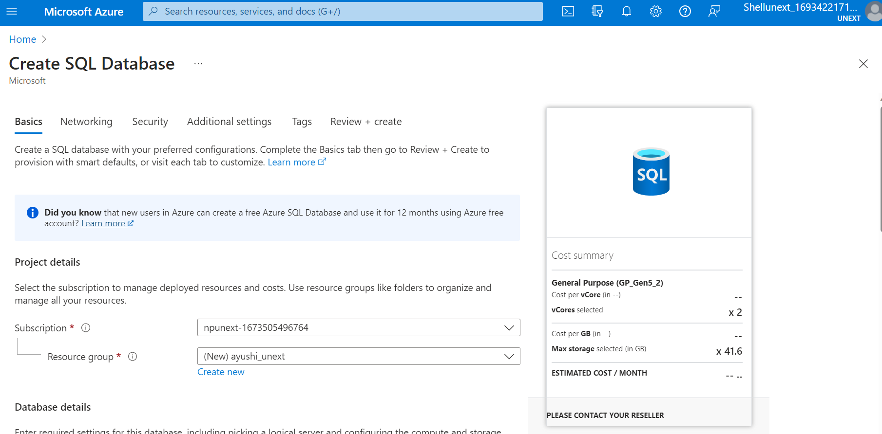
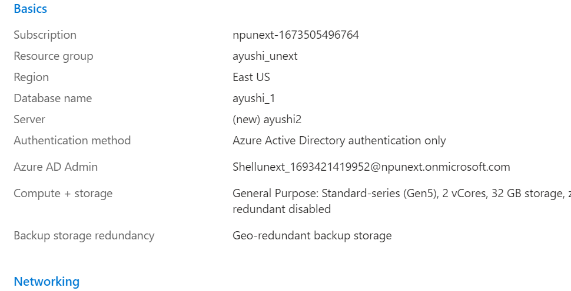
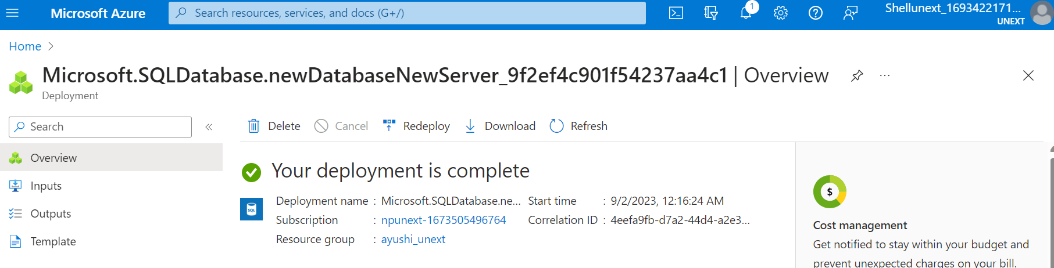
.

Slide 20
Day-14 (1st September 2023 ) Azure SQL
Joins
Constraints
Aggregate functions
Where Clause
Row Functions
Logical Operators
Stored Procedures
Union, Intersection, Union All
Indexing

Slide 21



